Slide 1
Visualizing Global Happiness
Sreya Chakrabarti
Varun Agarwal
arpitha kashyap

Slide 2
Motivation
One of the main motivation for the project was to get an understanding of the factors involved in the welfare of different countries
Happiness and Mental Health are important factors in many research fields. The data helped us get a lot of insights on various factors and its influence on the country's happiness rank
Happiness Scores play a major role in policy making
Variation of happiness scores across countries can help identify factors that have scope for improvement
Notes:
With an increase in social awareness and concern across the world, topics such as mental health and happiness of individuals have become important factors in various fields of research. Happiness reports have been studied in many research works to understand how they can relate to policy-making. Our motivation for this project is to explore the happiness data set and see what factors contribute the most in increasing or decreasing happiness scores across the years.

Slide 3
Relevant work and existing visualizations
Happiness reports of 2012 and 2013 by experts in fields of economics, psychology and survey analysis
The reports outlined the state of world happiness, causes of happiness, misery and policy implications.
World Maps and Bar Charts have been used extensively to drill down the data
Several kernels in Kaggle have various interesting visualizations for the same data set
Notes:
The first World Happiness Report was released on April 1, 2012. The report outlined the state of world happiness, causes of happiness and misery, and policy implications highlighted by case studies.
Kaggle, as the dataset was taken from Kaggle website there were many relevant works in the discussion forums regarding types of visualizations and methods to improve them
Second Happiness report in 2013 .experts in fields including economics, psychology, survey analysis, and national statistics, describe how measurements of well-being can be used effectively to assess the progress of nations, and other topics.
Economics of happiness has gained substantial support and interest with researchers, and is continually being researched for more practical applications.

Slide 4
Research goals and hypothesis
Various factors contribute to an individual’s or a nation’s happiness across the world.
Check the economic status of individuals in a country
Observe changes in happiness index for countries over a period of time
Notes:
The major research goal is to visualize how various factors contribute to an individual’s or a nation’s happiness across the world, and whether these factors differ from region to region.
Another factor which interests us is to check whether the economic status of individuals in a country is most conducive to a higher happiness index
Observe the changes in happiness index for countries over a period of three years (from 2015 to 2017) to evaluate the major causes of the change

Slide 5
Explaining the data
Happiness Scores for approximately 150 countries
Columns in Data set - Country, Region, Happiness Rank, Happiness Score, Economy, Family, Health, Trust on Government, Freedom, Generosity and Dystopia Residual
Factors such as Economy, Health etc. add up to the Happiness Score
Timeline of data - 2015 to 2017
Notes:
We have obtained a data set from Kaggle which lists the happiness scores for about 150 countries for 2015 to 2017. It also lists out factors such as Economy, Family and Health, which are factors that contribute to the calculation of Happiness Score. The data is in such a manner that all the contributing factors add up to the Happiness Score.

Slide 6
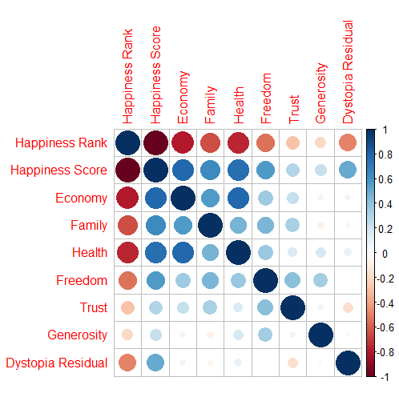
Notes:
The plot above shows the correlation of factors such as Economy, Family etc with Happiness Scores and with each other. It seems that Economy, Family and Health have the highest correlation with Happiness Score, whereas Trust and Generosity have a comparatively lesser correlation with Happiness Scores

Slide 7
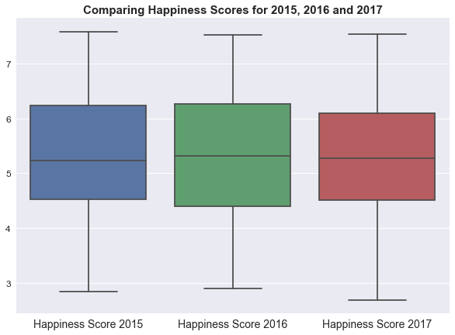
Notes:
The graph shows us the range of happiness scores for each of the years. There is not much of a difference in the range of the happiness scores, but we can see that the median happiness score for 2016 is slightly higher than that for 2015 and 2016. This gives us the inference that 2016 was a slightly happier year than 2015 and 2017.

Slide 8
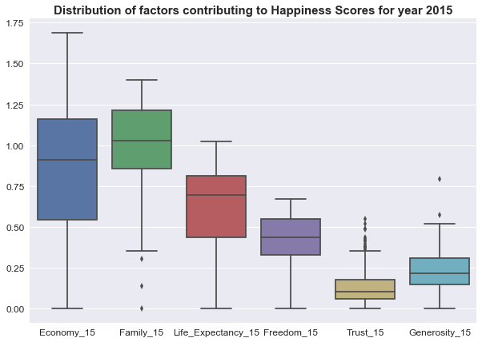
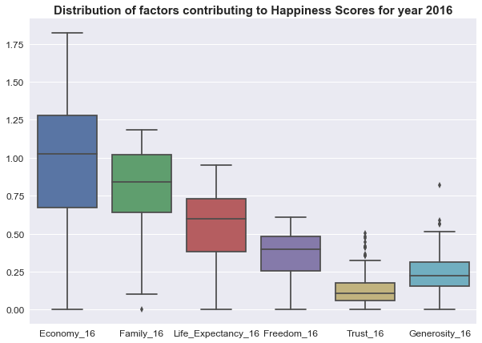
Notes:
The distribution of factors contributing to happiness scores are shown here for 2015 and 2016. From these graphs, you can see the range of each of the factors’ contribution to the happiness score. For 2015 Family seems to have the highest contribution to the Happiness Score. For year 2016, economy seems to have the highest contribution to the Happiness Score.

Slide 9
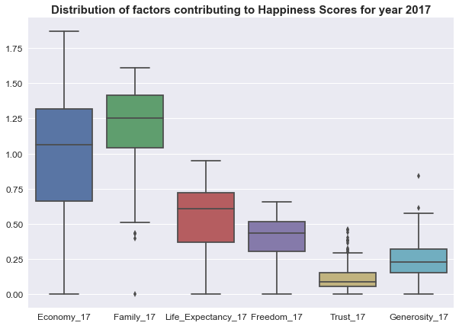
Notes:
For year 2017, we see a similar trend to that of year 2015, with family being the overall highest contributor to happiness scores. The median values of all of these factors in the boxplot give us an intuition about their contribution towards calculating the happiness score.

Slide 10
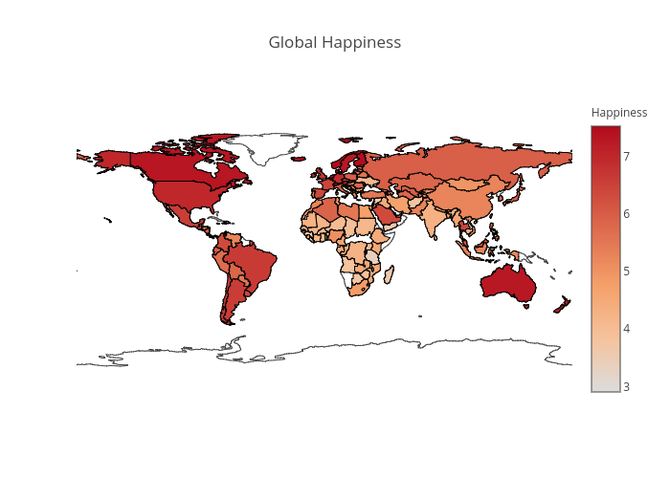
Happiness Scores Across the Globe (2017)
Notes:
This visualization shows us how the happiness score varies across the countries for the year 2017
The color bar represents the approximation of the color to the happiness score
The happiness score across regions like North America, Europe and Australia seem to be high. This can be due to factors like
Economy, Family, Health etc. However Regions like Africa and Southern Asia have lesser score possibly due to the same factors.

Slide 11
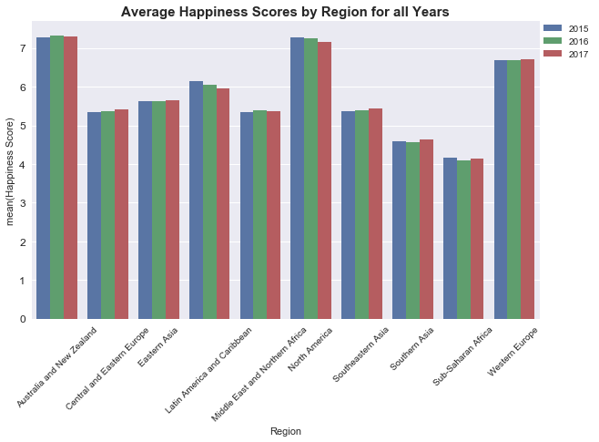
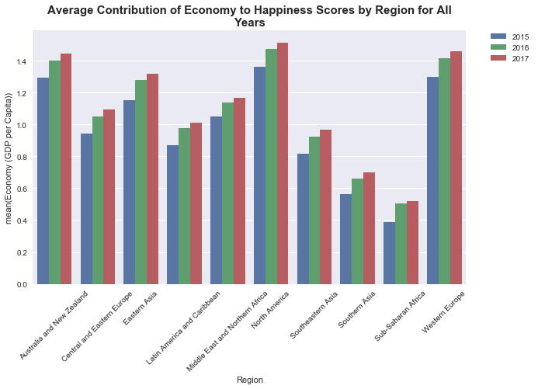
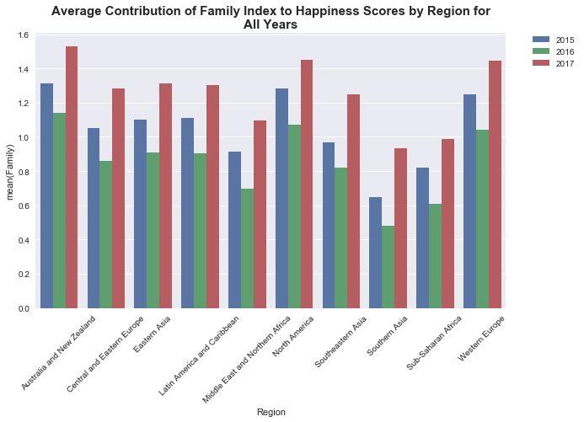
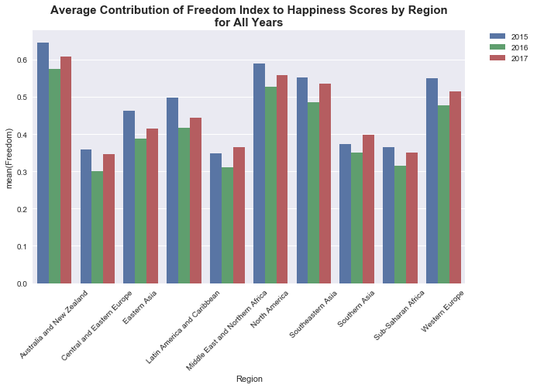
Notes:
These are barcharts that represent categorical data (regions in this case) and the average value of the factors affecting the happiness score across three years. You can clearly see the increase or decrease across the years.
In the graph for economy , we can clearly see that it has increased in all regions from 15 to 17.

Slide 12
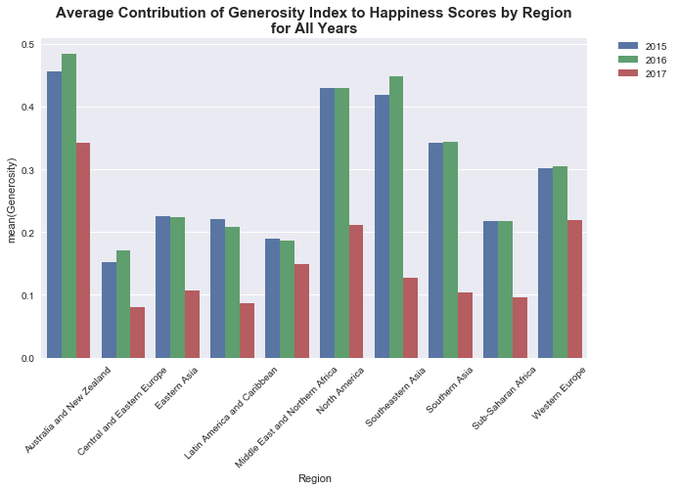
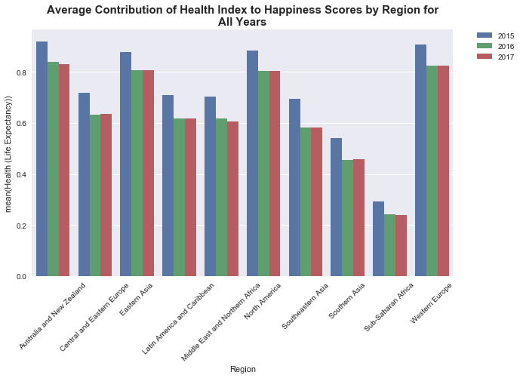
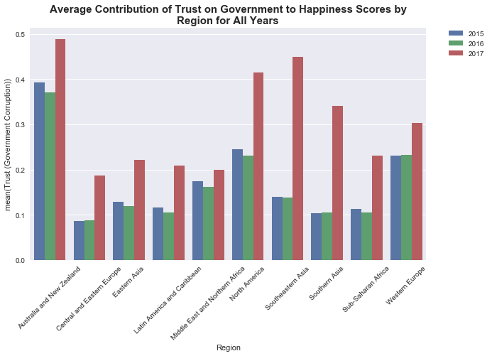
Notes:
The contribution of generosity to happiness has decreased over the years
The contribution of Health as well has reduced over the years
The trust on govt however has been a major contributor to happiness especially in 2017.

Slide 13
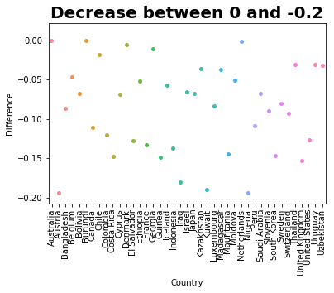
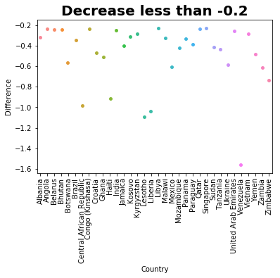
Decrease of Happiness Score from 2015 to 2017
Notes:
In the plots above, we can see the decrease of happiness score among countries from 2015 to 2017. Countries showing a 0 difference value indicates that the Happiness score has been constant from the last 3 years. However, countries having a negative difference indicates the drop in happiness score since 2015. In the plot above we can see that Venezuela has the maximum decrease in Happiness score since 2015.

Slide 14
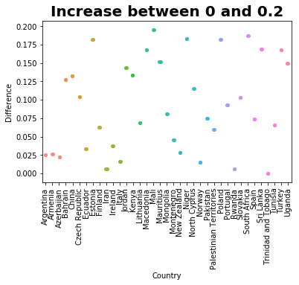
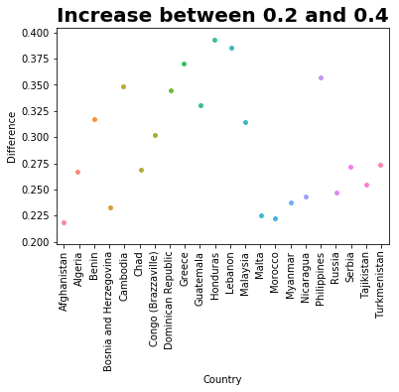
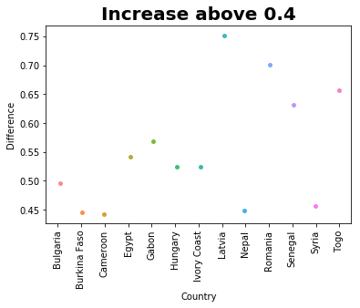
Increase of Happiness Score from 2015 to 2017
Notes:
The plot above shows the increase in Happiness score from 2015. The highest increase is shown by Latvia.

Slide 15
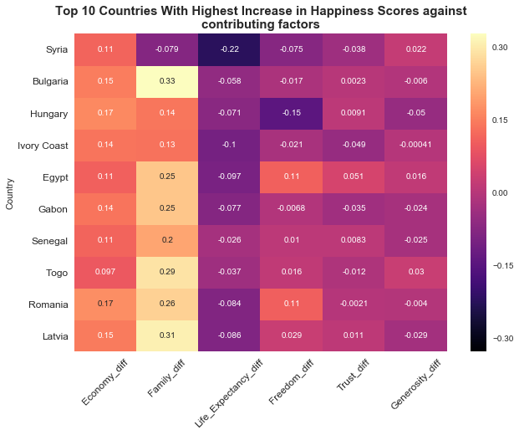
Notes:
This plot expands on the contributing factors of the 10 countries with highest increase in happiness scores, to see which factors had the most contribution in increasing the happiness scores for those countries. We can see very well here that Economy and Family (in the first and second column) have increased substantially for all the countries

Slide 16
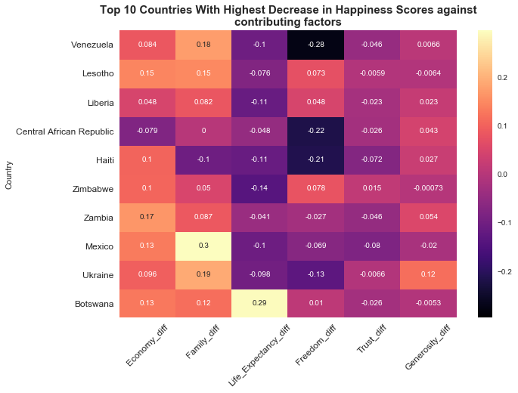
Notes:
This plot shows the decrease in contributing factors for the top 10 countries with the highest decrease in happiness scores from 2015 to 2016. From this graph, we can infer that life expectancy has seen a decrease for all the countries here. Even the freedom quotient has decreased substantially for Venezuela, Central African Republic and Haiti.

Slide 17
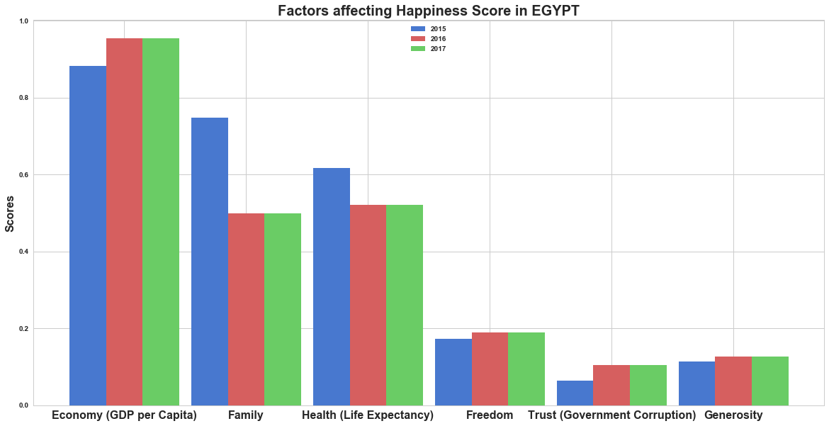
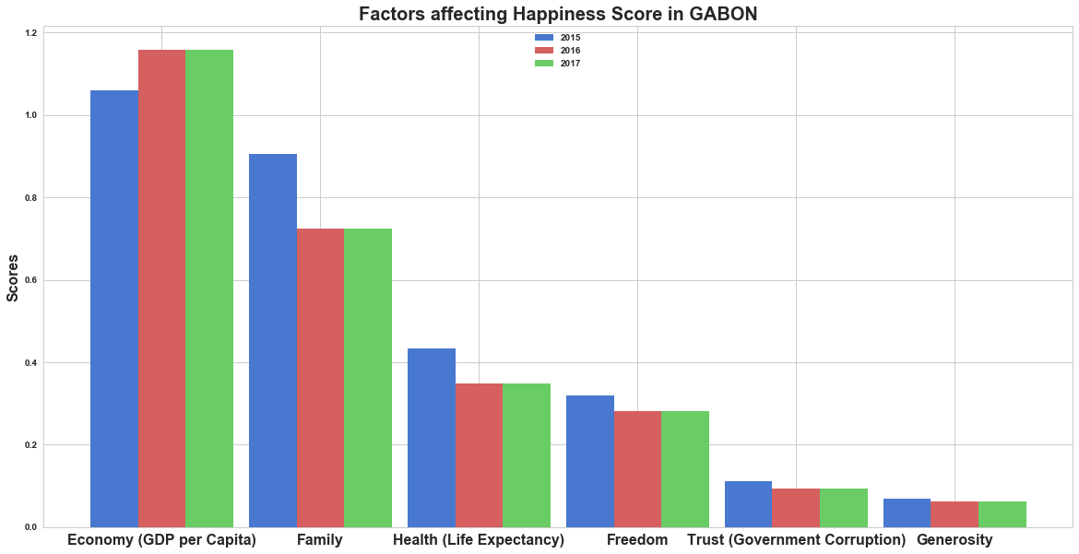
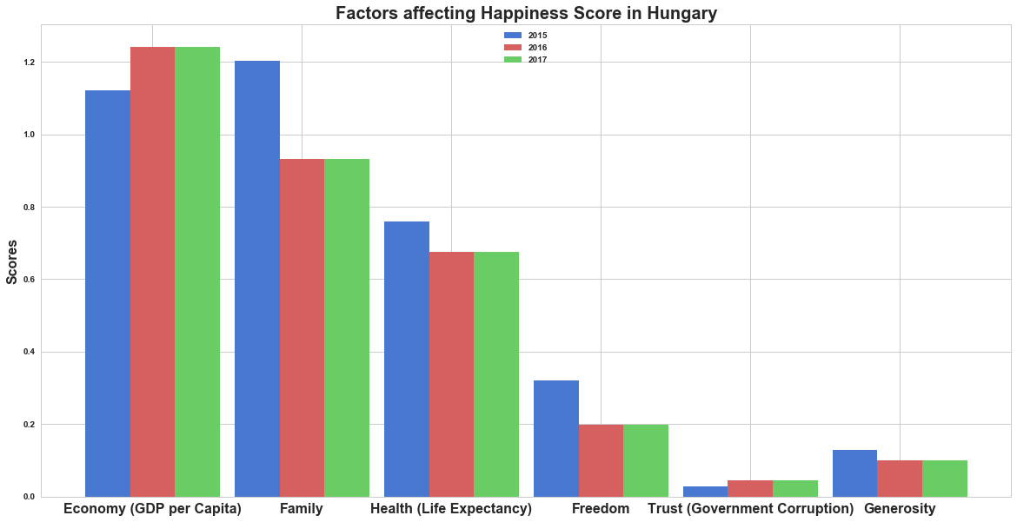
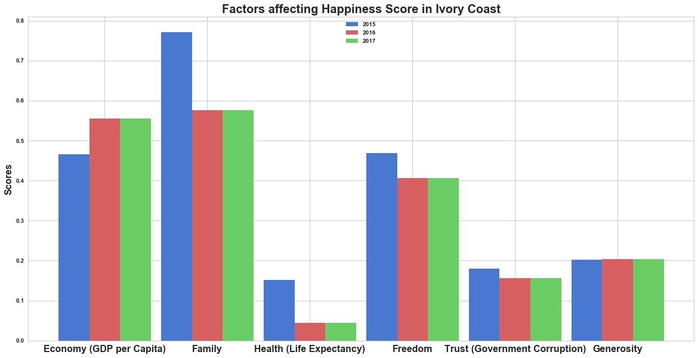
Notes:
This simple bargraph represents how each factor affects happiness score across all three years for a particular country.
We can see that, for the top 8 countries that have increase in happiness score across the three years, Economy plays a major role in influencing happiness. This is followed by Health and Freedom.
Factors such as Trust or Government Corruption and generosity doesn’t contribute much to happiness of the country. Instead they
Contribute to the sadness.

Slide 18
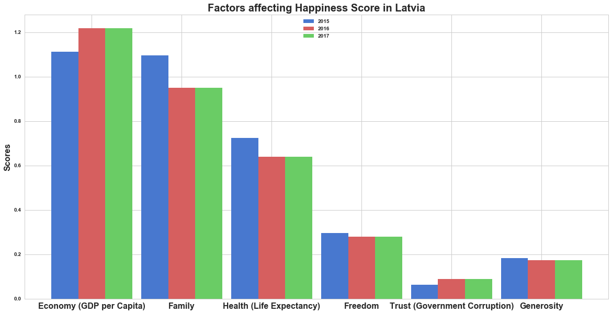
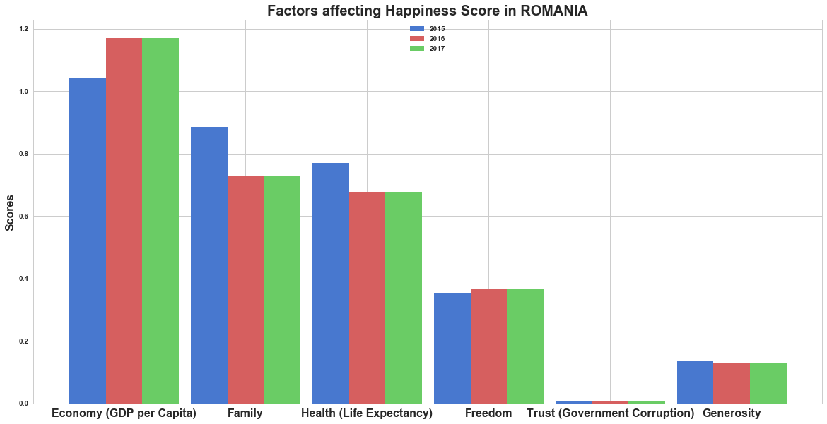
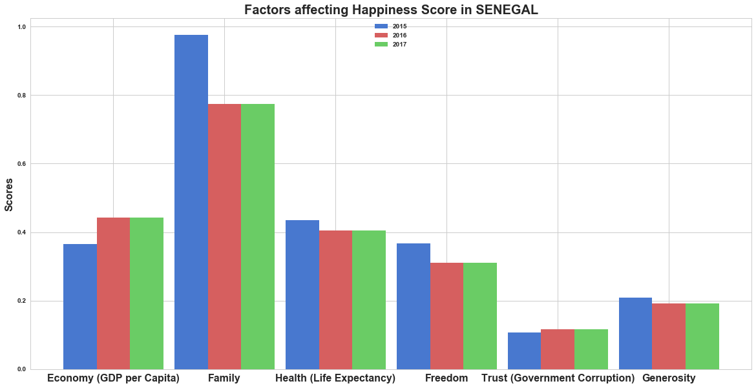
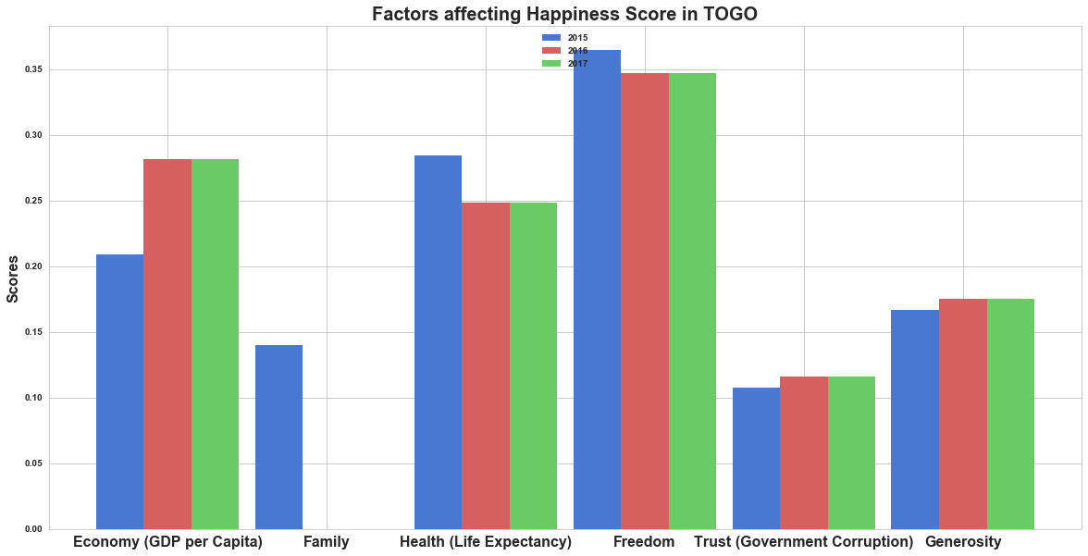
Notes:
It is clear how increase in economy has led to increase in happiness. We can conclude that Economy is the major factor that influences how happy a country is or is not.

Slide 19
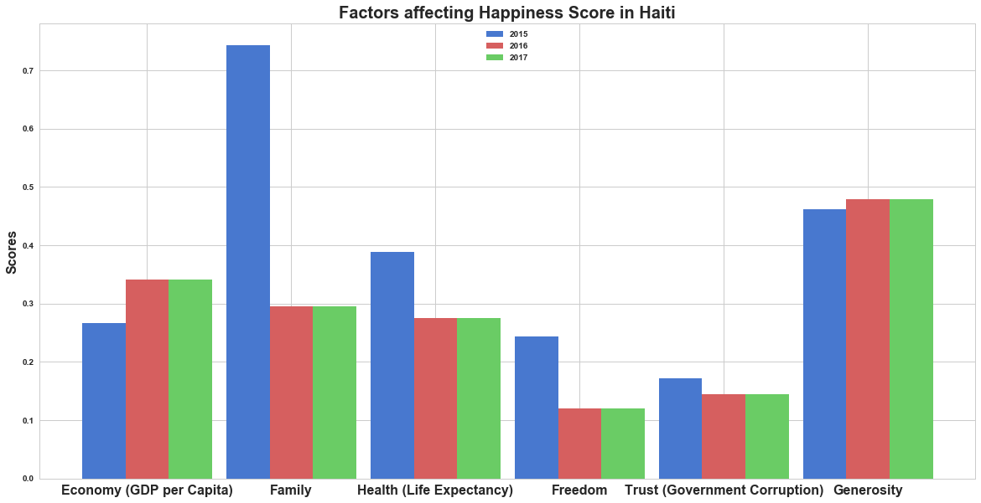
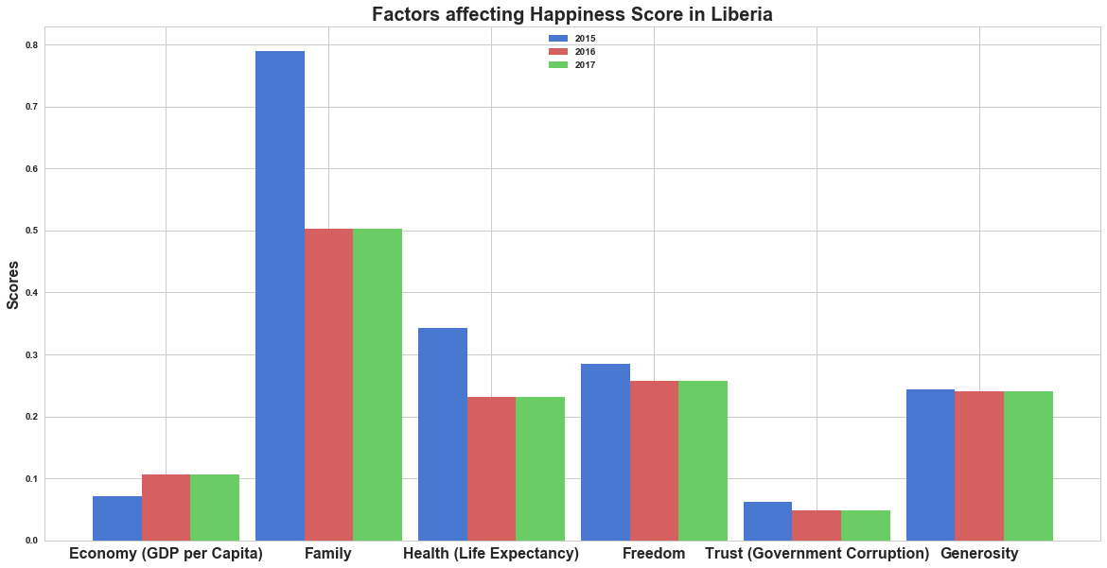
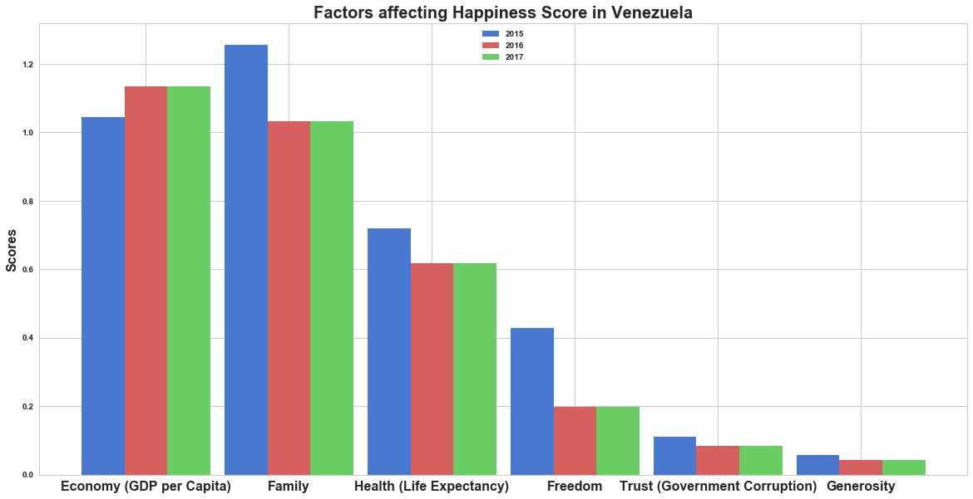
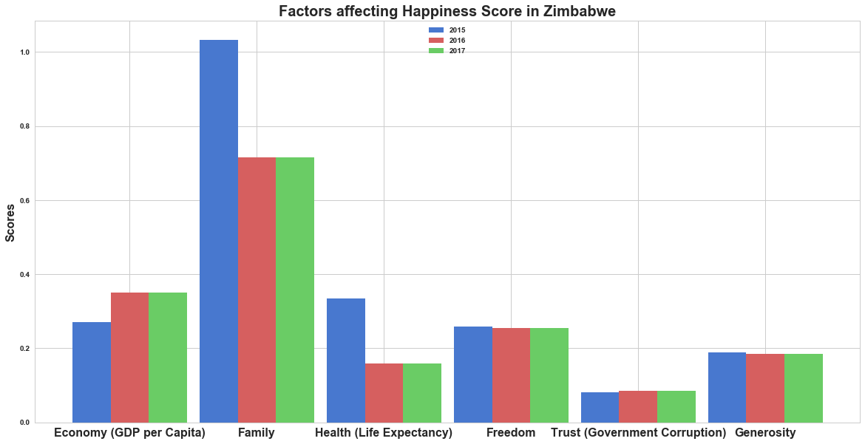
Notes:
These bargraphs represent the decrease in happiness score across the three years. The Major factors influencing this is Family and health. It is clear that they have decreased tremendously from 2015 to 17. Factors like generosity and trust don’t seem to have changed much and hence haven’t contributed much to the decrease in happiness.

Slide 20
Future Work
Further deep-dive into trends observable from current data
Further explore the dystopia residual factor in the dataset
To find more socio-economic factors outside the present data which can influence the happiness score of countries.
Research into luxury conveniences and contentment with lifestyle as factors during life evaluation
Notes:
Future work for this project includes extracting more trends from this data that explore factors that have a major contribution to increases or decreases in happiness scores across the world, and connect these factors with major socio-economic events across the world. We also want to explore more socio-economic factors outside this data set to meet our goals. Hope you liked our presentation. Thanks!

